Slide 1

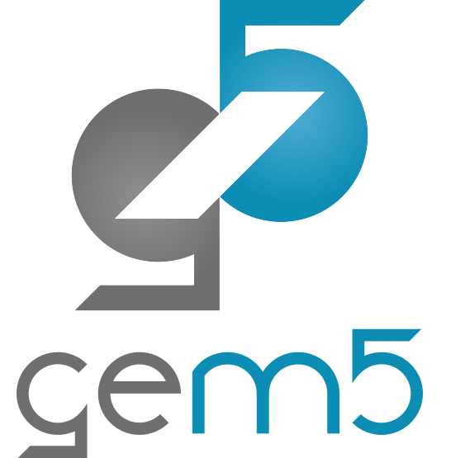

gem5-CXL: A Full-System Multi-Host Simulation Infrastructure
Leonardo Redivo, Mahyar Samani, William Shaddix, Kaustav Goswami, Venkatesh Akella, Jason Lowe-Power

Slide 2
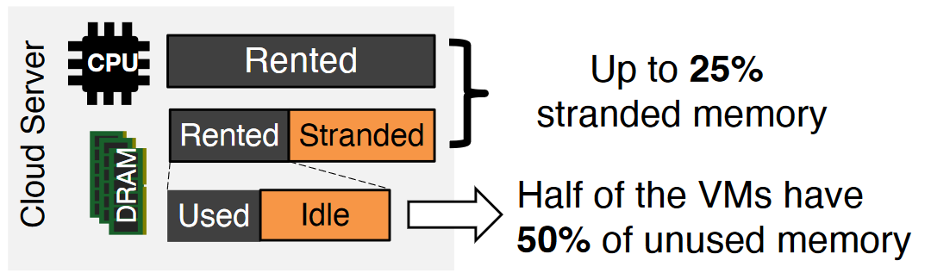
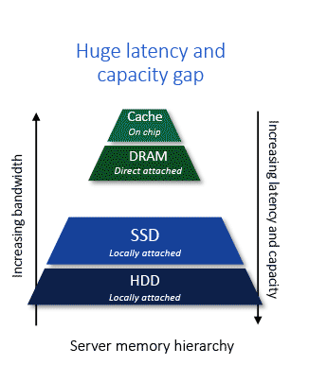
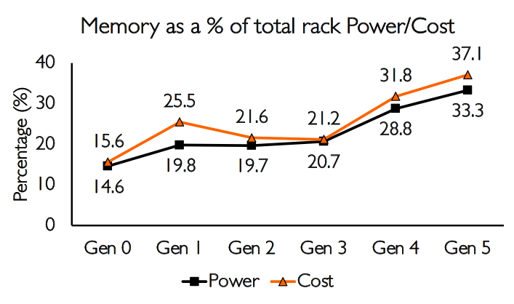
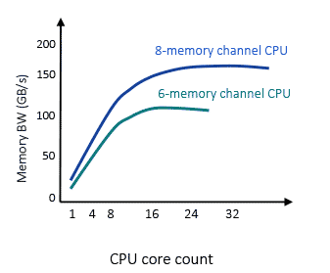
Data Center Challenges
Source: Microsoft
Source: Meta
Source: Rambus
Notes:
Modern data centers face three major problems to total cost of ownership.
Firstly, there currently is a latency and capacity gap with traditional monolythic servers between local memory and storage. SSD latencies are an order of magnitude higher than that of dram (from 100s of ns to 10s us).
Secondly, core counts have scaled faster than memory bandwidth, which leads to cores being starved for bandwidth.
Lastly, there is a growing amount of stranded memory in data centers due to memory and compute resources being coupled together. This combined with memory taking up a higher percentage of the overall cost of warehouse scale computers leads to higher TCOs

Slide 3
Why
Compute eXpress Link?
Shared
Memory
Pool
Memory expansion
Smart NIC
GPU
Memory expansion
VRAM
CXL
Coherent
Interconnect
X86 System
Memory expansion
DRAM
ARM System
Memory expansion
DRAM
Notes:
CXL is an open standard for a high-speed, low-latency, cache coherent interconnect technology for processors, accelerators, and memory expansion devices that was built on top of PCIe
The system depicted here is an example of a possible setup using the CXL interconnect. In this system, CXL enables direct access into the local memory of any attached device. CXL would also maintain memory coherency between the memory spaces of these devices.
CXL can address the challenges covered before by decoupling computing and memory resources.
Memory expansion cards through cxl can also close the latency and capacity gap between current DRAM and SSDs

Slide 4
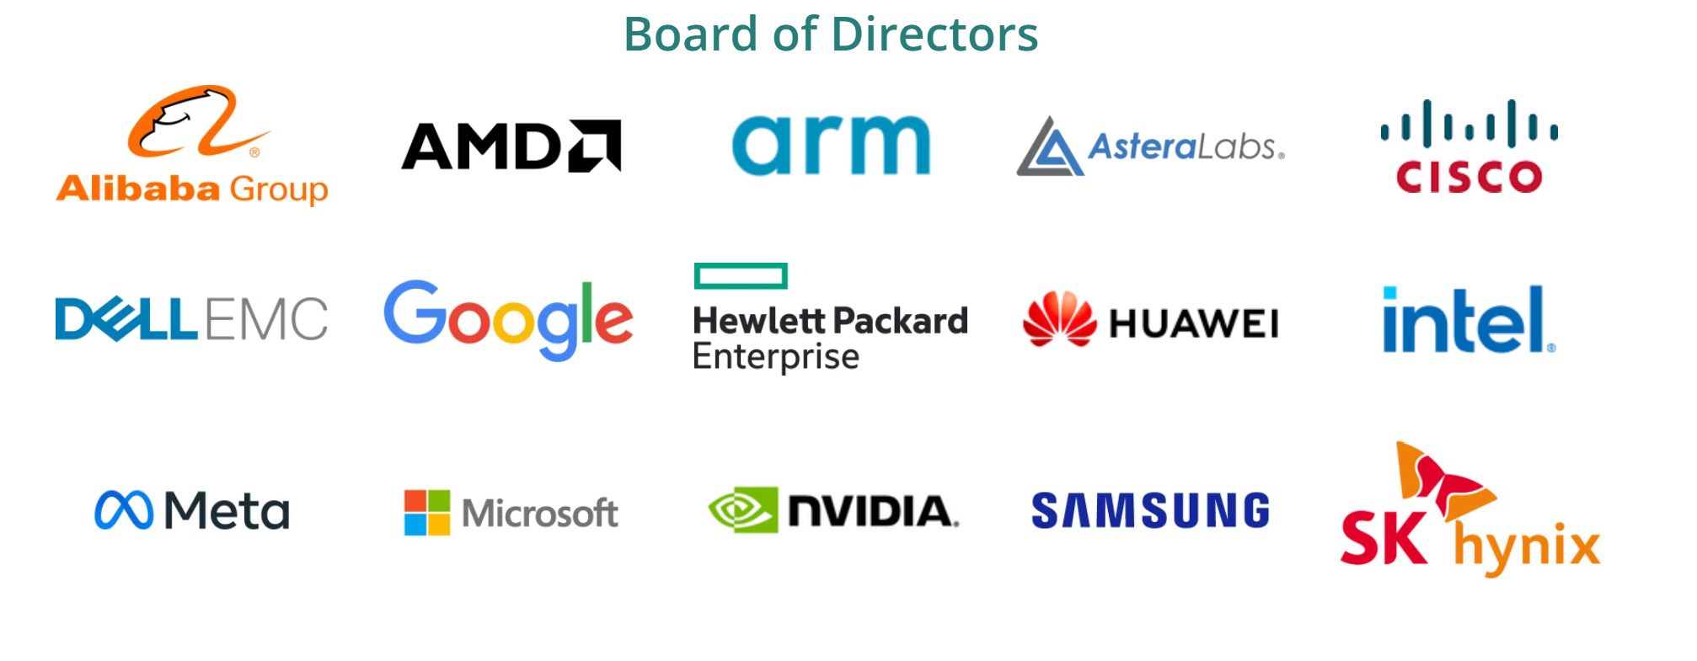
Motivation
High support but lack of working hardware
Notes:
CXL promises to be highly supported with 193 companies being members of the CXL consortium and overall research related to this technology at an all time high.
However, there is a Lack of existing CXL 3.0 devices and CXL Switches
Current evaluation of CXL systems:
CXL 1.1 memory expansion, through FPGAs or ASICs
Emulation of CXL via QEMU and NUMA

Slide 5
Limitations With Current Evaluation Methods
ASICs and FPGAs are limited to single-host setups
  Only as memory expansion devices
Emulation lacks microarchitectural modeling
  No accurate data on DRAM access delays.
Existing simulators lack full-system capabilities or can’t simulate multiple hosts

Slide 6


Goals
Modularity
Multi-device simulation
Heterogeneous ISA cluster simulation
Coherent address space
Enable new research
Notes:
gem5-CXL is an extension of the gem5 simulator that enables simulation with CXL-like devices in a multi-host, full system environment.
Project goals:
Provide a platform for multi-device simulation
Simulate clusters of heterogeneous ISAs
Enable coherent communication between devices
Enable research into areas of disaggregated systems that were unavailable with previous evaluation methods.

Slide 7
gem5 Modularity
Board
12 core
X86 CPU
MESI
2-Level
Caches
32 GB 4-channel
4800 MT/s DDR5
MESI
3-Level
Caches

Slide 8
gem5 Modularity
Board
MESI
2-Level
Caches
12 core
X86 CPU
MESI
2-Level
Caches
32 GB 4-channel
4800 MT/s DDR5
MESI
3-Level
Caches

Slide 9
gem5 Modularity
MESI
2-Level
Caches
Board
MESI
3-Level
Caches
12 core
X86 CPU
MESI
2-Level
Caches
32 GB 4-channel
4800 MT/s DDR5

Slide 10
gem5 Modularity
MESI
2-Level
Caches
Board
12 core
X86 CPU
MESI
3-Level
Caches
32 GB 4-channel
4800 MT/s DDR5

Slide 11
gem5-CXL Modularity
Board 1
12 core
X86 CPU
MESI
2-Level
Caches
32 GB 4-channel
4800 MT/s DDR5
Board 2
24 core
X86 CPU
MESI
3-Level
Caches
16 GB 8-channel
3200 MT/s DDR4
Notes:
Following the same principle, we have created a Cluster object that takes in a list of boards and connects them together via a user-configurable network.
The boards in this cluster are existing mainline board objects with a new parameter called “remote_port” which connects to the CXL network.
These boards are also modular, in the sense that you can have a cluster with boards with different characteristics
For ease-of-use and reproducibility, we have created a CXLSubSystem object, which is a gem5 standard library object that can be imported to a regular gem5 run scripts.
We have also created a Cluster object that takes in a list of hosts and devices, and functions like gem5’s board objects.
Lastly, we extended gem5’s board objects (like X86Board) to have a new “remote_port”.
This means that to use the infrastructure, a user can simply create multiple boards (instead of 1 in a regular gem5 simulation), import and create this CXLSubSystem object, and create a cluster object with the list of boards and the CXLSubSystem as arguments.

Slide 12
gem5-CXL Modularity
Board 1
12 core
X86 CPU
MESI
2-Level
Caches
32 GB 4-channel
4800 MT/s DDR5
Board 2
24 core
X86 CPU
MESI
3-Level
Caches
16 GB 8-channel
3200 MT/s DDR4
Notes:
Following the same principle, we have created a Cluster object that takes in a list of boards and connects them together via a user-configurable network.
The boards in this cluster are existing mainline board objects with a new parameter called “remote_port” which connects to the CXL network.
These boards are also modular, in the sense that you can have a cluster with boards with different characteristics

Slide 13
gem5-CXL Modularity
CXL Sub-System
16 GB 8-channel
3200 MT/s DDR4
CXL Sub-System
32 GB 4-channel
4800 MT/s DDR5
Notes:
We have created a CXLSubSystem object, which is a gem5 standard library object that can be imported to a regular gem5 run scripts.
CXL SubSystem takes in a memory configuration which can be changed according to the user’s preferences.
This object connects to the cluster and is addressable by the boards in it.
These changes allow us to use this infrastructure with the minimal amount of changes to existing scripts. To use the infrastructure, a user can simply create multiple boards (instead of 1 in a regular gem5 simulation), import and create this CXLSubSystem object, and create a cluster object with the list of boards and the CXLSubSystem as arguments.

Slide 14
gem5-CXL Modularity
CXL Sub-System
16 GB 8-channel
3200 MT/s DDR4
CXL Sub-System
32 GB 4-channel
4800 MT/s DDR5
Notes:
We have created a CXLSubSystem object, which is a gem5 standard library object that can be imported to a regular gem5 run scripts.
CXL SubSystem takes in a memory configuration which can be changed according to the user’s preferences.
This object connects to the cluster and is addressable by the boards in it.
These changes allow us to use this infrastructure with the minimal amount of changes to existing scripts. To use the infrastructure, a user can simply create multiple boards (instead of 1 in a regular gem5 simulation), import and create this CXLSubSystem object, and create a cluster object with the list of boards and the CXLSubSystem as arguments.

Slide 15
Current Design
CXL SubSystem
To Host Boards
CXL Host Port
CXL Host Port
CXL Host Port
Ruby
CXL Host Controller
CXL Host Controller
CXL Host Controller
CXL Network
CXL Device Controller
To Device
Notes:
Let’s take a closer look to the CXL SubSystem. To connect these boards together and enable communication with a CXL style device we implemented the following:
We have implemented a new SLICC protocol alongside new ruby memory controller objects. These enable communication between host nodes and device nodes (memory expansion cards).
At the moment, we are only able to simulate a single CXL device, however, this board is still fully customizable in terms of memory technology.
These controllers communicate with the device via a network object that can be set up in a user-customizable topology.

Slide 16
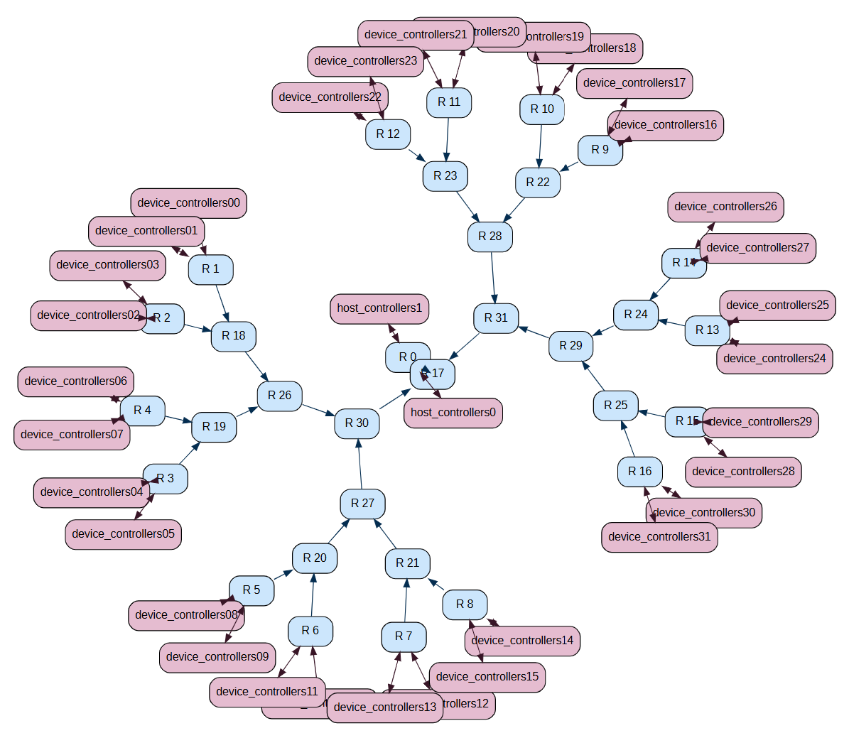
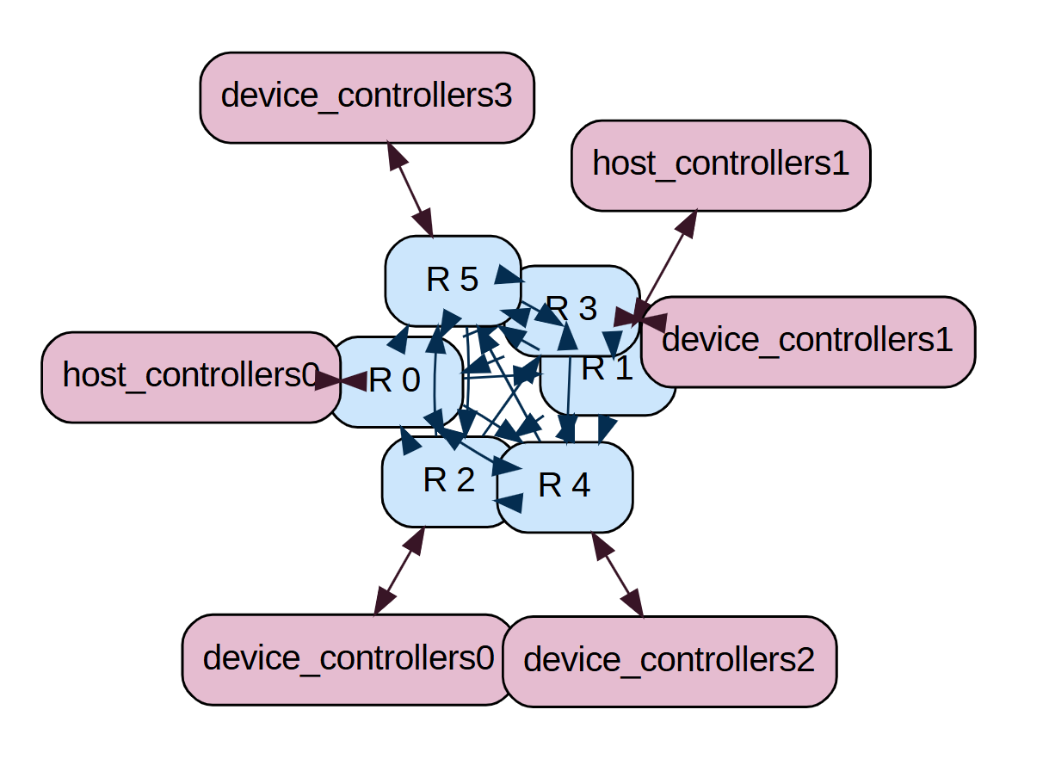
Customizable Networks
Peer-to-Peer Topology
Tree Topology
Notes:
These controllers communicate with the device via a network object that can be set up in a user-customizable topology.

Slide 17
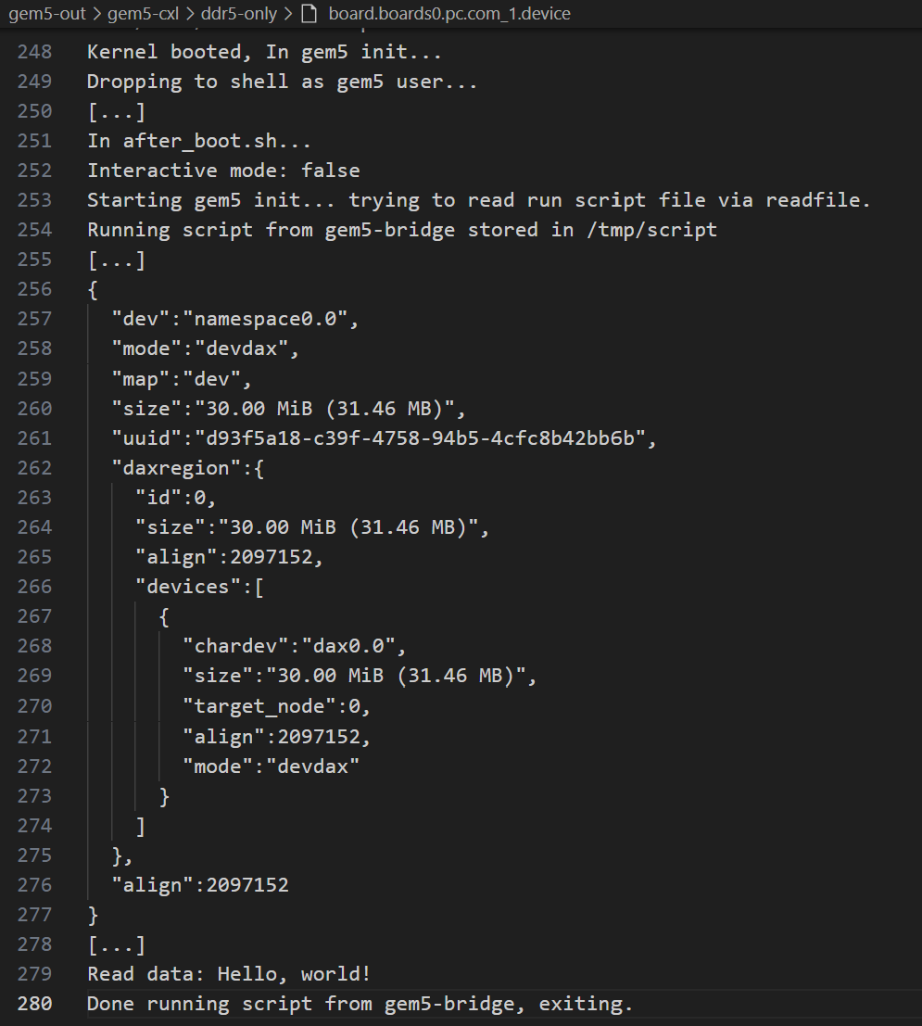
Full System Simulation
Notes:
With this system we are able to run full system simulations.
This simple full system example writes than reads “Hello, world!” to and from the CXL memory expansion device, which we expose in linux as a devdax device.

Slide 18
Existing Prototype, Limitations, and Future Goals
Our work today:
  Interchangeable network topologies
  Full-system simulation of disaggregated clusters
Existing Limitations:
  Lack of non read-only shared memory workloads
  Long simulation time
What we are working on:
  Multi-device simulation
  Heterogeneous ISA clusters
  CXL Coherence Protocol
Notes:
In conclusion, we have created a cycle-level CXL simulator that is able to do full-system simulation in a cluster of machines that all have access to a single memory expansion CXL device. This cluster is fully modular, both in number of host systems and the characteristics the hosts and device. Additionally, we can implement distinct network topologies connecting hosts and the device together.
We do, however, still have a few limitations. These include: the long simulation time of large clusters and the lack of benchmarks that are able to take full advantage of a coherent shared distributed memory.
Lastly, we are actively still working on extending the capabilities of this infrastructure, with our main goals being the following: enabling multi-device simulation; simulation of heterogeneous ISA clusters; and implementation of the CXL coherence protocol.

Slide 19
Thank You!
Happy To Take Questions!

