Slide 1
Implementing Support for Extensible
Power Modeling in gem5
Alex Smith and Matthew D. Sinclair
University of Wisconsin-Madison
sinclair@cs.wisc.edu

Slide 2
Why Is This Important?
Faster hardware
Improved algorithms (e.g., deeper DNNs)
Larger Datasets
Moore’s Law has enabled a virtuous cycle of progress in many fields
… slowing of Moore’s Law also threatens progress
Modern apps have ravenous (exponential) compute, power needs
Must co-optimize for performance and power
2

Slide 3
What Is Needed?
Need disruptive, cross-layer changes to meet future sys. reqs.
  Co-design arch, runtime, OS, compiler, network, batch sched.
  For both power and performance (and maybe other factors)
  Increasingly important as transistor sizes shrink
Typically sim. & modeling tools enable early-stage design exploration
  Recent work: scalably enable accurate co-design for performance
  But what about power?
Need credible, open-source modeling infrastructure for both
3

Slide 4
Power Modeling State-of-the-Art
5 broad types of power models:
  Extrapolate first-principal models (e.g., CACTI [Wilton JSSC’96], McPAT [Li MICRO’09])
    Were highly accurate, still widely used … but not updated in 8+ years
  Empirical measurement-based models (e.g., AccelWattch [Kandiah MICRO’21])
    Difficult to generalize beyond specific devices they are measured on
    Significant accuracy decrease for even minor perturbations
  ML-based models (e.g., [Kumar MLCAD’19], [Wu HPCA’15])
    Tremendous potential, but accuracy often lacking for previously unseen devices
  Tools based on tape-out values
    Time consuming, expensive, can only happen later in design process
  Low-level Spice models
    Accurate, but often require proprietary information, hard to scale to large systems
Early-stage power model tools divided, arch-specific, out-of-date
How do we support diverse options in gem5?
4

Slide 5
What Can We Do?
Additional Challenges:
  Each power modeling approach may be “best”
  Often certain power models easier to integrate with certain simulators
Insight: decouple “best” power model from simulator integration
  Don’t pick which power model is the right one
  Abstract away how simulators integrate → plug-and-play power models
Vision: make power modeling as easy as performance modeling
Today’s Focus: Application to gem5
5

Slide 6
Outline
Motivation
Background
Design
Methodology & Results
Conclusion & Future Work
6

Slide 7
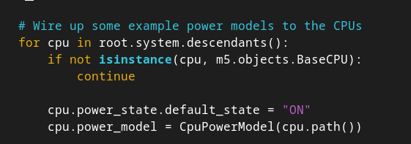
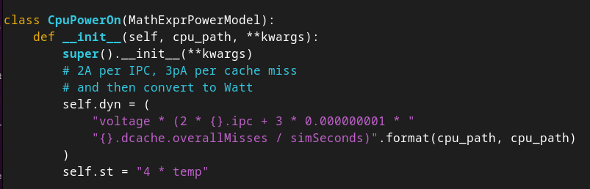
Current Power Modeling in gem5
Power modeling API takes user-defined equations as strings
  Simulation statistics passed in as variables (e.g., cache hits)
7

Slide 8
Current Power Modeling in gem5 (Cont.)
Power modeling API takes user-defined equations as strings
  Simulation statistics passed in as variables (e.g., cache hits)
  Limitation: Difficult for users to express complex functions, novel models
Partial McPAT integration
  But not updated in many years …
Partial DVFS & thermal support
Some ISAs have better power support (ARM [Reddy PATMOS‘17])
  But also not updated in many years …
Foundation to build off/learn from
8

Slide 9
Outline
Motivation
Background
Design
Methodology & Results
Conclusion & Future Work
9

Slide 10
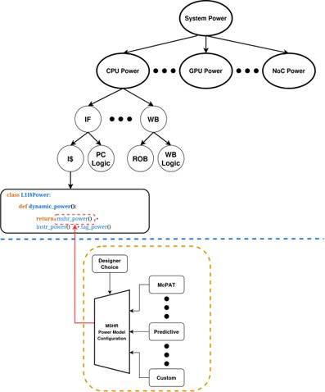
Extending Power Modeling API [OSCAR’24]
How should we extend the power modeling API?
Provides users interface which enables fine-grained customization
10

Slide 11
Extending the Power Modeling API (Cont.)
Hierarchical system of components
  Overall power model: sum of components
  Separate simulator, power model
Break model into 3 Key Pieces:
  Simulator organizes hardware into sub-groups (e.g., known good models)
  Power model(s): express static, dynamic power per component
  Interface: pick between power models for a given component
11

Slide 12
Putting It All Together
Uses gem5’s Python front-end
  Can change power model choice as easily as cache size (no recompile)
  Richer way to add support, easy to modify
  Could use different power models for different components
Architecture-agnostic
  New power model “just” provides static, dynamic power values per component
  Simulator handles rest of integration (plug-and-play)
Can integrate and compare/validate different power models
  Existing power models (e.g., McPAT)
  Pre-built power models
  Custom power models (e.g., in-house)
12

Slide 13
Example: McPAT Power Model
Integrate McPAT [Li MICRO’09] into our new interface
  Models 5 stages (Fetch, Execute, LSU, Memory, Renaming)
  Uses first principles for hierarchical modeling
Basic Flow with new interface:
  Grab McPAT activation energies
  Activation energies with gem5 stats → power/component (e.g., BP, RF)
  Hierarchically sum power/component into per stage, then per core, etc.
13

Slide 14
Example: McPAT Power Model
Integrate McPAT [Li MICRO’09] into our new interface
  Models 5 stages (Fetch, Execute, LSU, Memory, Renaming)
  Uses first principles for hierarchical modeling
Our interface enables breaking down PM into separate functions!
class O3McPATCPUPowerOn(PowerModelPyFunc):
def __init__(self, cpu: BaseO3CPU, act_energies):
...
self._fetch = O3McPATFetchPower(cpu, act_energies, 1.0, 0.9)
self._exec = O3McPATExecutePower(cpu, act_energies, 1.0, 0.76)
self._lsu = O3McPATLsuPower(cpu, act_energies, 1.0, 0.71)
self._mmu = O3McPATMmuPower(cpu, act_energies, 1.0, 0.71)
self._rnu = O3McPATRenamingUnitPower(cpu, act_energies, 1.0)
def dynamic_power(self):
return self._fetch.dynamic_power() + ... + self._rnu.dynamic_power()
14

Slide 15
Example: McPAT Power Model (Cont.)
Deeper Dive Into Fetch stage modeling:
from mcpat_power_model import McPATPowerModel # Base class defining helper fns
class O3McPATFetchPower(McPATPowerModel):
def __init__(self, cpu, act_energies, pipeline_act_factor, ifu_act_factor):
...
self._decode = O3McPATDecodePower(cpu, act_energies)
...
def dynamic_power(self):
return (
self._decode.dynamic_power()
+ ...
)
class O3McPATDecodePower(McPATPowerModel):
def __init__(self, cpu, act_energies):
...
def dynamic_power(self):
return self.to_watts(self.inst_buffer_energy() + self.inst_decode_energy())
def inst_buffer_energy(self):
decoded_insts = self.get_stat(decode.decodedInsts)
return (
decoded_insts * self.act_energies[“IB”][“Read”]
+ decoded_insts * self.act_energies[“IB”][“Writes”]
)
15

Slide 16
Outline
Motivation
Background
Design
Methodology & Results
Conclusion & Future Work
16

Slide 17
Methodology
Benchmarks:
  gem5-Resources (e.g., Hello World)
  a*X + Y (*AX, *AXPY) variants
CPUs: Timing, Minor, O3 (all 1 core/thread)
Goal: validate gem5 McPAT integration vs. standalone McPAT
  Use same configuration and statistics as gem5
  Turned off m5ops (ROI markers) due to instr. count variations
17

Slide 18
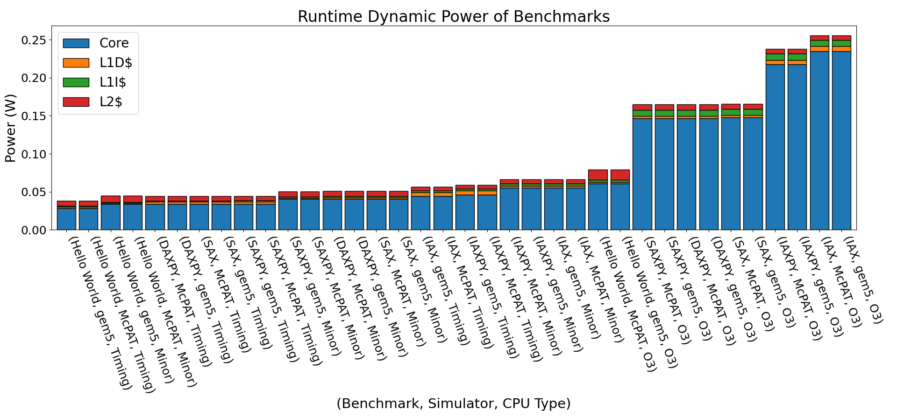
Preliminary Results
a*X > a*X + Y?
Ints > FP > DP?
Mostly follow expectations (e.g., O3 > Minor > Timing), closely match McPAT!
Why Do These Results Occur?
18

Slide 19
Preliminary Results (Cont.)
Several unintuitive results … did we integrate McPAT poorly?
  No! Results properly reflect McPAT’s behavior
Unintuitive results highlight McPAT several flaws:
  Does not model vector instructions
  Does not distinguish between single and double precision
Takeaways:
  New interface faithfully models McPAT
  Enables rapid prototyping of power models via Python
  Interface allows quality evaluation of known/new power models
19

Slide 20
Outline
Motivation
Background
Design
Conclusion & Future Work
20

Slide 21
Conclusion
Future systems need to balance power, performance even more
But power models are out-of-date, brittle, or proprietary
Insight: decouple simulator power model integration, power model
  Simulator devs: focus on how power should be integrated …
  … without worrying about specifics of underlying power model
Potential Benefits:
  Easily support & simple to change between many different power models
  Better maintainability – separate power model and simulator design
  Easier to integrate new power models (e.g., for novel accelerators)
  Integration with mainline gem5 ongoing
Make power modeling as easy as performance modeling
21

Slide 22
BACKUP
22

Slide 23
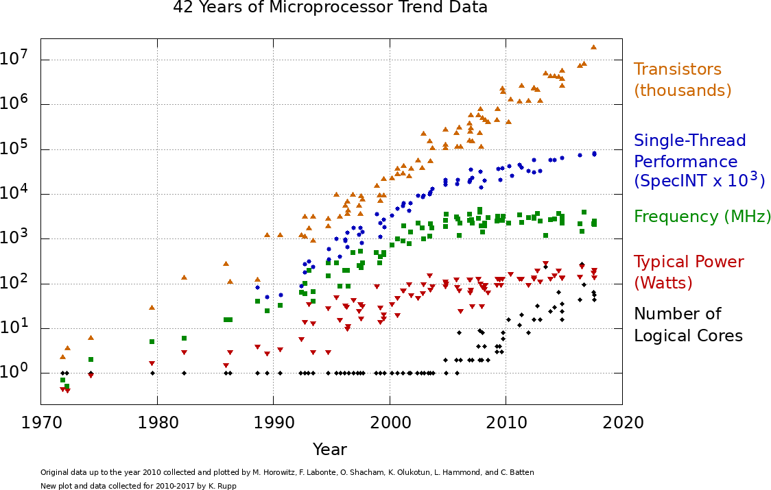
What are Future System Reqs?
One example – recent DOE CFP Requirements:
  100+ exaFLOPs, up to 20 GHz frequency, < 20 MW power
  But Moore’s Law continues to fade …
23

Slide 24

Why gem5?
Widely used, popular, open-source simulator
  Models CPUs, GPUs, and accelerators in a single ecosystem
  Supports many layers of the computing stack – enables deep co-design
  Extensible through C++/Python modules
Significant software engineering effort
  Validated, cycle-level fidelity across a range of components
  Rigorous functional regression testing ensures stability
    On-going work: performance regression testing
  Stable interfaces reduces churn
24

Slide 25
Power Modeling Flow
Current flow:
  Grab McPAT activation energies
  Use activation energies with gem5 stats to calculate power per component (BP, RF, etc)
  Hierarchically sum the power per component into per stage, then per stage to core.
class MinorFetchEnergy(BasePowerModel):
self.dynamic_power():
energy = (
reads * self.act_energies[‘Read’]
+ writes * self.act_energies[‘Write’’]
)
return to_watts(energy)
class MinorCPUPower(PowerModelPyFunc):
self._fetch = MinorFetchPower()
self.dynamic_power():
return self._fetch.dynamic_power()
McPAT Activation Energies
25

Slide 26
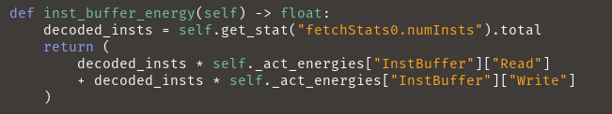
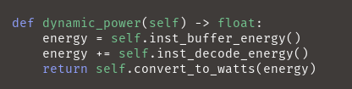
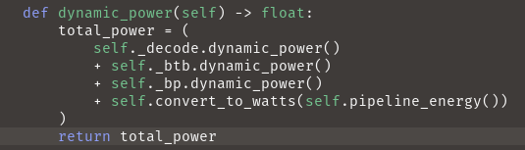
Implementation
InorderMcPATDecodePower()
InorderMcPATDecodePower()
InorderMcPATFetchPower()
26

