Slide 1
SecureView:
Visualizing Defense against Transient Execution Side Channels
gem5 Workshop 2025, Tokyo
22-06-2025
Philipp Schmitz, Tobias Jauch, Alex Wezel, Mohammad R. Fadiheh, Thore Tiemann, Jonah Heller, Thomas Eisenbarth, Dominik Stoffel, Wolfgang Kunz

Slide 2
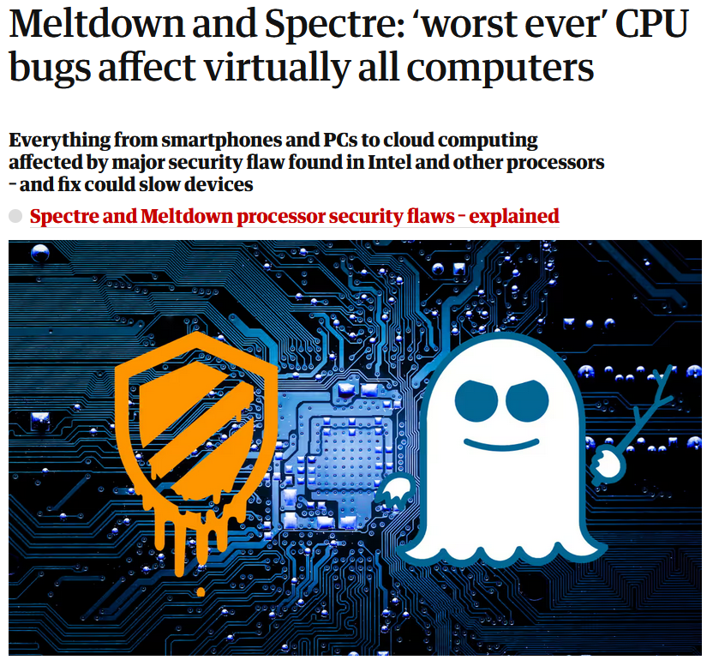
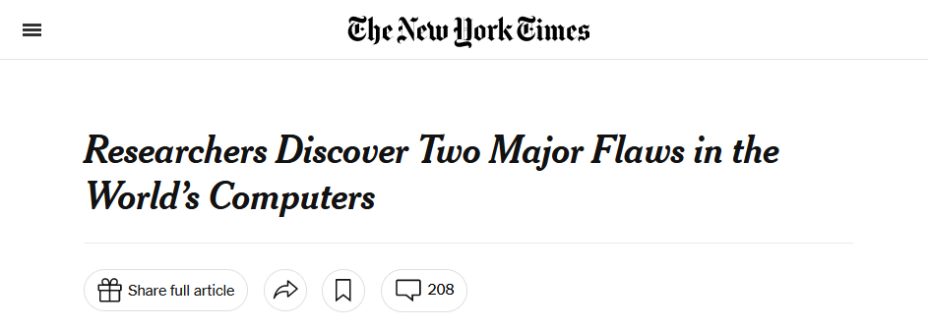
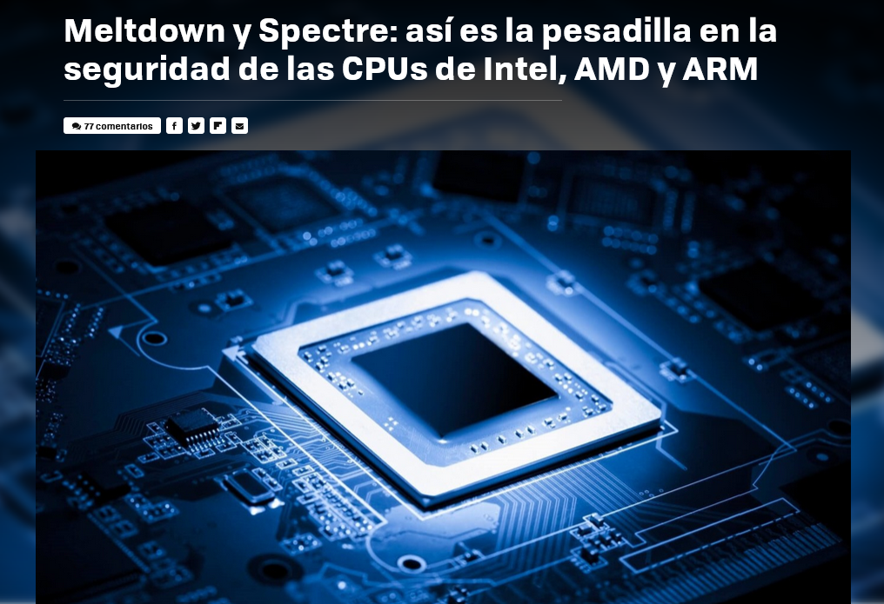
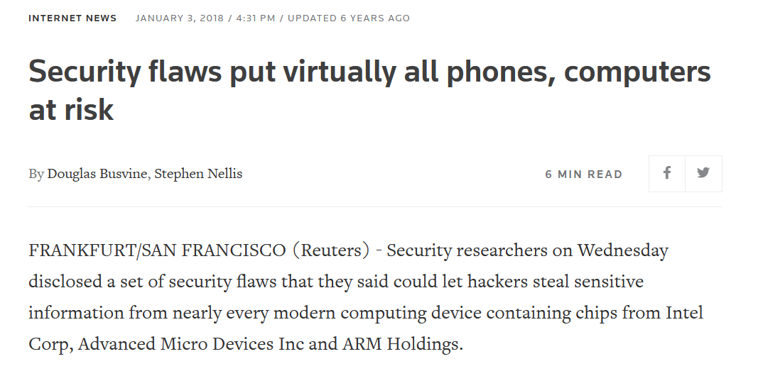

Slide 3
Background – Transient Execution Side Channels
Transient Execution Side Channel (TES) attacks exploit side effects of instructions that are executed speculatively or out of order and later discarded due to mis-speculation or an exception.
Although the architectural state is reverted afterwards, these instructions leave a microarchitectural footprint that can be used to reveal confidential data.

Slide 4
Background – Transient Execution Side Channels
if ( x < array1size) {
val = array1[x];
y = array2[val * 256];
}
array1
secret
array2
Memory

Slide 5
Background – Transient Execution Side Channels
if ( x < array1size) {
val = array1[x];
y = array2[val * 256];
}
array1
secret
array2
Access the secret based on attacker-chosen index x
Memory

Slide 6
Background – Transient Execution Side Channels
if ( x < array1size) {
val = array1[x];
y = array2[val * 256];
}
array1
secret
array2
Transmit the secret by accessing a primed array based on the secret value
Memory

Slide 7
Mitigations
Researchers and industry develop mitigations to prevent attacks
  Software:
    Add speculation barriers to the kernel
  Hardware:
    Close high bandwidth channels (i.e., cache)
    Selectively delay instructions
BUT: Prototyping hardware is a costly process
Notes:
„Long term research objective“ martin Dickson

Slide 8
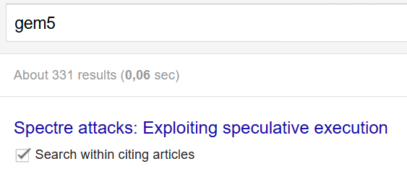
Mitigations
Researchers use gem5 for fast prototyping
  Flexibility
  Insight and debug capabilities
  Good performance estimate
  Is the architecture secure?
Notes:
Fly in STT

Slide 9
Security Reasoning
Pen-and-paper proofs
Automated Design-Time Testing [Fu et al.]
Launching sample attacks
  Success or fail
  How is the attack mitigated?

Slide 10
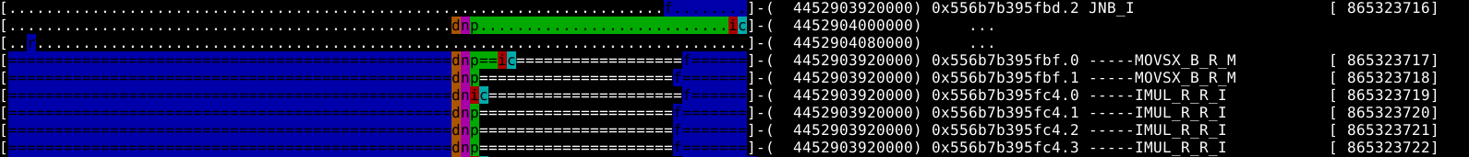
o3PipeView
Timepoints for fetch, decode, rename, dispatch, issue, complete, retire
PC, macro-operation, sequence number

Slide 11
SecureView
Goal: gain insight how mitigations work
  Debugging
  Education
Augment the gem5 pipeline viewer with TES-related information
  Which instructions potentially open a transient window
  Which instructions are blocked by the mitigations

Slide 12
Speculation
What can cause instructions to be under speculation?
  Control-Flow
  Exceptions
  Memory Dependencies
  Memory Ordering
→ Common property used by almost all hardware mitigations

Slide 13
Speculation
Speculative Shadows [Sakalis et al.]
  Unresolved speculation “casts a shadow” on younger instructions in the ROB
  Mark instructions as shadow-casting upon insertion
  Regularly check shadow-casting instructions and resolve shadows

Slide 14
SecureView
Create an additional line for security information
The example snippet shows a Casting instruction and when it is Resolved
Visualize when succeeding instructions are considered unsecure

Slide 15
Mitigations
Eager Delay [Sakalis et al.]
Speculative Taint Tracking (STT) [Yu et al.]
Okapi [Schmitz et al.]
Delay all speculative load (access) instructions

Slide 16
Mitigations
Eager Delay [Sakalis et al.]
Delay all speculative load (access) instructions

Slide 17
Eager Delay
Mark loads as unsecure upon insertion in the ROB if there is an older shadowing instruction and unmark them when all older shadows are resolved
Block loads immediately before going to the TLB
Reschedule blocked loads that are no longer shadowed

Slide 18
Mitigations
Eager Delay [Sakalis et al.]
Speculative Taint Tracking (STT) [Yu et al.]
Okapi [Schmitz et al.]
Delay all speculative load (access) instructions
Speculative access instructions initiate a taint bit

Slide 19
Mitigations
Speculative Taint Tracking (STT) [Yu et al.]
Speculative access instructions initiate a taint bit
Speculative tainted transmit instructions are blocked
Resolve taints when the youngest root of taint is non-speculative

Slide 20
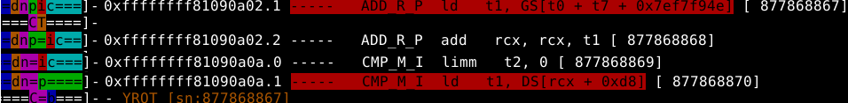
STT
Mark initialized Taints
Block tainted transmitters and display the YRoT sequence number

Slide 21
Mitigations
Eager Delay [Sakalis et al.]
Speculative Taint Tracking (STT) [Yu et al.]
Okapi [Schmitz et al.]
Delay all speculative load (access) instructions
Loading from a data page enables a safe access bit (SAB)
Speculative access instructions initiate a taint bit
Speculative tainted transmit instructions are blocked
Resolve taints when the youngest root of taint is non-speculative

Slide 22
Mitigations
Okapi [Schmitz et al.]
Loading from a data page enables a safe access bit (SAB)
Speculative loads targeting pages with a set SAB are permitted
Speculative loads without SAB are blocked

Slide 23
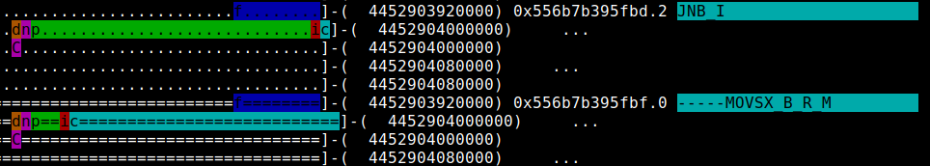
Thwarting an example Attack

Slide 24
Thwarting an example Attack

Slide 25
Conclusion & Future Work
Simple tool for visualizing core aspects of a mitigation
Helps analyzing the details of an attack
Display more detail for the intermediate tainting steps
Find a new way to visualize the TLB or memory interface

Slide 26
Literature
[Fu et al.] – B. Fu, L. Tenenbaum, D. Adler, A, Klein, A. Gogia, A. R. Alameldeen, M. Guarnieri, M. Silberstein, O. Oleksenko, and G. Saileshwar. 2025. AMuLeT: Automated Design-Time Testing of Secure Speculation Countermeasures. (ASPLOS '25).
[Sakalis et al.] – C. Sakalis, S. Kaxiras, A. Ros, A. Jimborean, and M. Själander. 2019. Efficient invisible speculative execution through selective delay and value prediction. (ISCA '19).
[Yu et al.] – J. Yu, M. Yan, A. Khyzha, A. Morrison, J. Torrellas, and C. W. Fletcher. 2019. Speculative Taint Tracking (STT): A Comprehensive Protection for Speculatively Accessed Data. (MICRO '19).
[Schmitz et al.] – P. Schmitz, T. Jauch, A. Wezel, M. R. Fadiheh, T. Tiemann, J. Heller, T. Eisenbarth, D. Stoffel and W. Kunz. 2025. Okapi: Efficiently Safeguarding Speculative Data Accesses in Sandboxed Environments. (AsiaCCS’25) (to appear)

Slide 27

Thank you!
Questions?
Contact me at:
philipp.schmitz@rptu.de

