Slide 1






The RISC-V Hypervisor Extension in gem5
Nick Karystinos
D
George-Marios Fragkoulis
University of Athens, Greece
gem5 workshop @ ISCA 2025
Sunday, 22 June

Slide 2
Background: RISC-V extensions
The ISA is designed to be extensible and modular
The base ISA provides the “essence” of computation
  1) Basic Arithmetic 2) Control Flow 3) Memory Operations
Optional ISA extensions (“bags” of instructions) provide additional functionality
Each extension is represented by a letter
  A – Atomic Instructions, B – Bit Manipulation, C – Compressed, D – Double Precision fp arithmetic, …

Slide 3
Background: RISC-V extensions
Why is the ISA designed to be extensible and modular?
RISC-V Mantra: Implement only what you need
  Can tailor the hardware to the application
  Hardware complexity ~ Complexity of ISA extensions needed
  Minimal ISA needs → Simple Hardware ☺

Slide 4
Background: RISC-V Hypervisor (H) Extension
H extension allows the efficient hosting of a guest OS
  Essentially: Virtualizes the supervisor-level architecture
Registers
  26 new CSRs
Interrupts & Exceptions
  9 new exception codes (4 new interrupts + 5 new exceptions)
Two-stage Translation
  G-stage Walking for guest physical to host physical translation
Hypervisor Instructions
  20 new instructions including memory fences and special memory instructions for hypervisor

Slide 5

H extension is now in gem5 ☺
  Pull request is merged onto staging branch of v25.0
Currently testing H extension with Timing CPU models
  Will upstream Timing CPUs support as well (when stable)
This talk High-level overview of the implementation + Demo
Notes:
Many thanks to Jason, Roger and everyone else involved for the reviews and insightful feedback

Slide 6
Implementation
Registers
  26 new CSRs
Interrupts & Exceptions
  9 new exception codes (4 new interrupts + 5 new exceptions)
Two-stage Translation
  G-stage Walking for guest physical to host physical translation
Hypervisor Instructions
  20 new instructions including memory fences and special memory instructions for hypervisor

Slide 7


Implementation Methodology: Registers
Read sstatus
OK!
csrr t2, sstatus
t2 = sstatus;
Linux (native – S mode)
OK!
☺
Read sstatus
csrr t2, sstatus
t2 = vsstatus;
Linux (guest – VS mode)

Slide 8
Implementation
Registers
  26 new CSRs
Interrupts & Exceptions
  9 new exception codes (4 new interrupts + 5 new exceptions)
Two-stage Translation
  G-stage Walking for guest physical to host physical translation
Hypervisor Instructions
  20 new instructions including memory fences and special memory instructions for hypervisor

Slide 9
Implementation Methodology: Exceptions
New fault types
  Virtual Supervisor and Guest Interrupts
  Guest-Page Faults
  Virtual ecall
  Etc.
Extended fault handling for new privileges
  HS (Hypervisor)
  VS (Virtual Supervisor)

Slide 10
Implementation
Registers
  26 new CSRs
Interrupts & Exceptions
  9 new exception codes (4 new interrupts + 5 new exceptions)
Two-stage Translation
  G-stage Walking for guest physical to host physical translation
Hypervisor Instructions
  20 new instructions including memory fences and special memory instructions for hypervisor

Slide 11
Background: Sv39 Scheme
38
30
29
21
20
12
11
0
VPN₂
VPN₁
VPN₀
offset
Virtual Address
9 bits
9 bits
Physical Address
(Lives in RAM)
9 bits
data
PA
L1 PTE
L2 PTE
L0 PTE
L2 Page Table
4KB Page
satp
L1 Page Table
PFN (44 bits)
L0 Page Table

Slide 12
Background: Two-Stage translation
VS-stage
(1st stage)
38
30
29
21
20
12
11
0
39-bit Guest Virtual Address
gVPN₂
gVPN₁
gVPN₀
offset
9 bits
9 bits
9 bits
L1 gPTE
data
L2 gPTE
Guest Virtual Address
vsatp
L0 gPTE
L2 Page Table
4KB Page
L1 Page Table
gPFN (44 bits)
Guest Physical Address
(Host Virtual Address)
L0 Page Table
Guest Virtual Address
12
0
21
11
29
20
G-stage
(2nd stage)
40
30
Host Virtual Address
gPPN₂
gPPN₁
gPPN₀
Host Physical Address (Lives in RAM)
L1 PTE
L2 PTE
hgatp
L0 PTE
PFN (44 bits)

Slide 13
Implementation
Registers
  26 new CSRs
Interrupts & Exceptions
  9 new exception codes (4 new interrupts + 5 new exceptions)
Two-stage Translation
  G-stage Walking for guest physical to host physical translation
Hypervisor Instructions
  20 new instructions including memory fences and special memory instructions for hypervisor

Slide 14
Implementation Methodology: Instructions
Extended ISA specification files with the new instruction implementations
  new fences (HFENCE, HINVAL) → selectively flushes TLB entries
  new loads & stores (HLV, HLVX, HSV) → hypervisor accesses memory as if the request originates from a virtualized guest
New memory instruction formats for hypervisor loads & stores

Slide 15
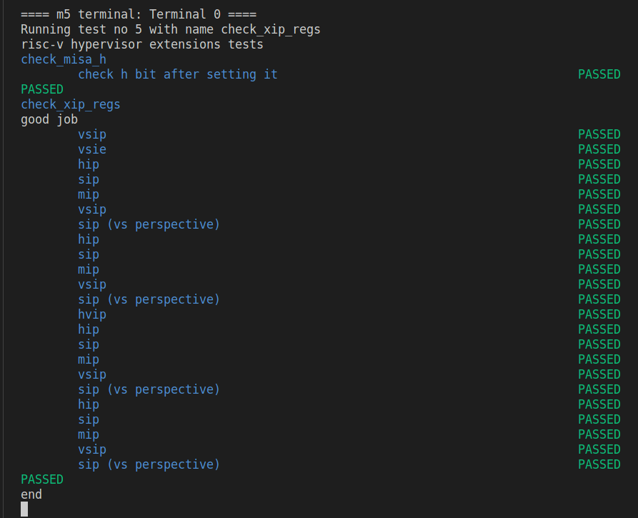
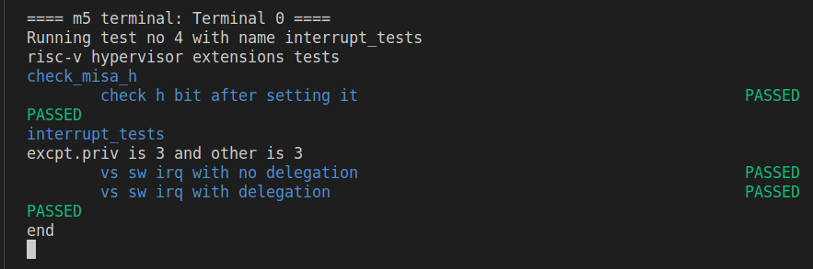
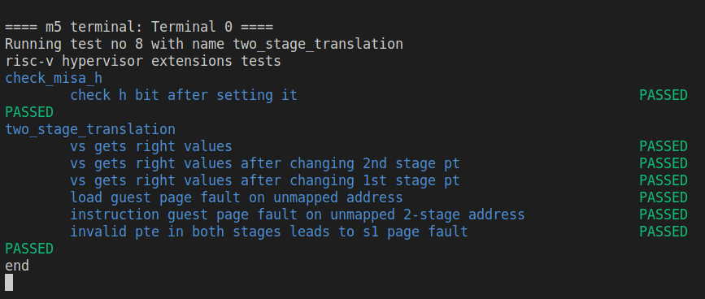
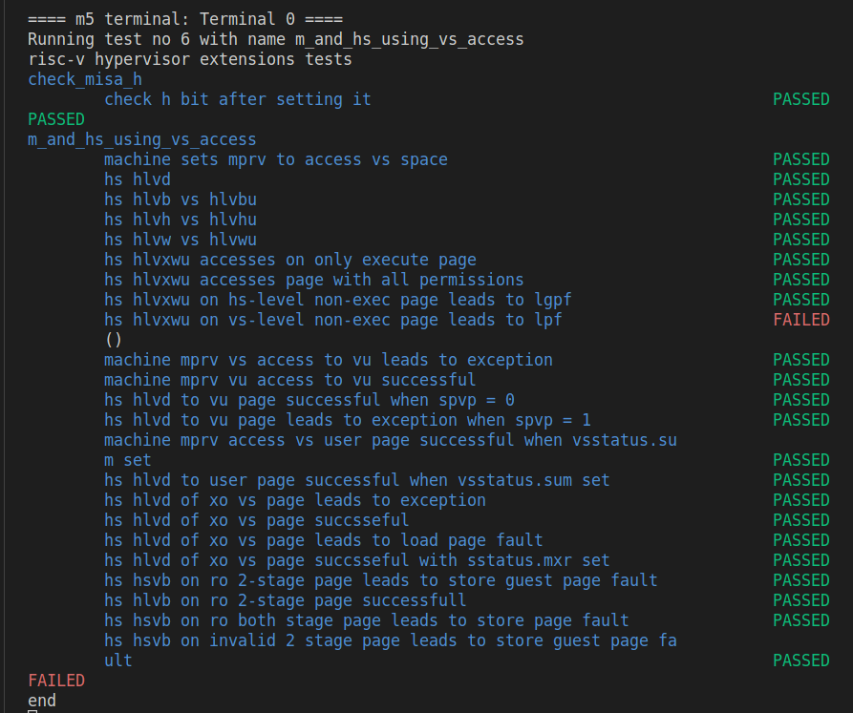
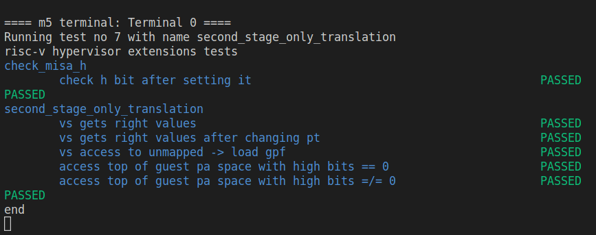
Implementation Methodology: Validation
Public Tests for H extension
Registers
Exceptions & HLV/HSV
Two-Stage Translation

Slide 16

Implementation Methodology: Validation
Run a hypervisor and a guest VM
  If the guest VM’s OS boots up and can execute programs
    we gain strong confidence in the correctness of our implementation
We choose to run Xvisor (a type-1 or baremetal hypervisor)
Xvisor Mascot

Slide 17

Live Demo Time ☺
Xvisor boot video
QR code points to our CARRV ‘24 paper for more details on the implementation
(You can also checkout the PR in the gem5 repository)
Notes:
Xvisor boot video

Slide 18
Thank you!
Questions?
Nick Karystinos
D
George-Marios Fragkoulis
University of Athens, Greece
gem5 workshop @ ISCA 2025
Sunday, 22 June

Slide 19
Background: RISC-V Address Translation
Supports classic paged virtual memory
  different address width translation schemes: Sv32, Sv39, Sv48
  gem5 implements Sv39 (39-bit virtual addresses) for now
H extension adds another translation stage (G-stage)

Slide 20
Implementation Methodology: Registers
64 bits (gem5 physical register)
16 bits (MIP CSR)
16 bits (HIP CSR)
63
15
13
12
11
10
9
8
7
6
5
4
3
2
1
0
…
000
sgeip
vstip
0
0
0
0
meip
0
vseip
seip
0
mtip
0
stip
0
msip
0
0
0
0
vssip
ssip
0
Problem: HIP should see purple bits only
Solution: Read/Write masks nullify the rest
of the bits!
Original bits
Physical Register
Additional H extension bits
Control Status Register (CSR)

Slide 21
Experimental Results
We obtain results from nine benchmarks from MiBench Suite
The programs’ full-system execution is simulated in gem5
  Natively (no virtualization)
  In a VM (virtualized environment)
We examine the following three types of simulation overheads
  Simulation Time overhead
  Instruction overhead
  Exception Handling overhead

Slide 22
Experimental Results: Time Overhead
~50% slowdown on average

Slide 23
Implementation Methodology: Translation
Extended page walking logic to support new types of walks
  G-stage
  Two-stage
    Virtual First Stage (guest virtual → guest physical)
    G-stage as Second Stage (guest physical → host physical)
Extended permission checking based on effective prv and V
  G-stage accesses are always checked as if prv == PRV_U
  Special Hypervisor memory instructions are executed as if V == true
  New page-fault types (e.g. guest load page fault)

Slide 24
H extension is now in gem5 ☺
  Pull request is merged onto staging branch of v25.0
We assess the functional correctness of our implementation
  H extension tests behave equivalently on Spike (reference ISA simulator)
  Ran Xvisor (a type-1 hypervisor) and guest VMs
Currently testing H extension with Timing CPU models
  Will eventually upstream Timing CPUs support as well

Slide 25
Experimental Results: Instructions Overhead
~5% more instructions on average

Slide 26
Experimental Results: Exceptions Overhead
Exceptions handled in S in native execution and in VS during guest execution
are equivalent

Slide 27
Background: RISC-V extensions
History of extensions relevant to cloud-computing in gem5 **
[2022] Bit Manipulation (B)
Jerin Joy
[2023] Cryptography (K)
Roger Chang
[2023] Vector (V)
Adrià Armejach, Xuan Hu, Fan Yang, Jerin Joy, Roger Chang, Hoa Nguyen and others
** Excuse the possibly incomplete/mistaken credits ☺
The missing piece:
H (hypervisor) extension
Cannot run guest VMs efficiently without this!!!
Notes:
What are the “needs” of cloud-computing?

Slide 28
Background: RISC-V Hypervisor (H) Extension
Virtualized
Environment
Non-Virtualized
Environment
0
User Space
U
0
VU
Guest User Space
Host User Space
U
1
OS
S
1
VS
Guest OS
2
Hypervisor
HS
3
Firmware
M
3
Firmware
M
“Classic” Privilege Levels
With H-extension

Slide 29
Thank you!
Questions?
George-Marios Fragkoulis
d
George Papadimitriou
Nikos Karystinos
D
Dimitris Gizopoulos
University of Athens, Greece
CARRV 2024
Sunday, 3 November

