Slide 1
Narrowing the GAP: Enhancing gem5’s GPU
Memory Bandwidth Accuracy
Yu Xia*, Vishnu Ramadas*, Matthew Poremba**, Matthew D. Sinclair*
*University of Wisconsin-Madison, **AMD Research
xia73@wisc.edu
Notes:
Good day everyone. My name is Yu, a student from the University of Wisconsin-Madison. Today, I will present our continued work on improving the accuracy of gem5’s GPU model. The work is a collaboration with Vishnu Ramadas, Matthew Poremba and Professor Matthew Sinclair

Slide 2
CPU-GPU SE Mode Support in gem5
Architects rely on simulators to rapidly prototype ideas
gem5 widely used (execution-drive, cycle level), supports CPU-GPU systems
AMD updated GPU support [Gutierrez, et al. HPCA ‘18]
  Simulates end-to-end HIP application (AMD’s GPGPU programming language) binaries
Recent updates (by us and AMD)
  Runs unmodified ROCm user stack
    ROCm 4.0 SE mode, ROCm 6.4 FS mode
  Full-system mode with GPUs connected via PCIe now supported (+ PyTorch) [Ramadas, et al. OSCAR’24]
  Supports ML apps [Roarty & Sinclair gem5 Wkshop’20]
  Recently added support for MI200/300 GPUs
HIP
VEGA ELF + Code metadata
HIP Libraries
Runtime loader loads VEGA ELF into memory
[Gutierrez et al., HPCA ‘18]
Validated simulator configurations are crucial
2
Notes:
Let’s start with some background. Researchers usually rely on simulators to rapidly implement and verify ideas. For GPUs, gem5 has its cycle-level, execution-driven model. In 2018, AMD Research updated the GPU support in gem5, which is capable to run real HIP applications. AMD and our group have been providing support to this model. Now it can run modern, unmodified ROCm stack, with support of dedicated GPU connected via PCIe in Full-system mode. It can also run various GPU applications. Recently, we made models for newer GPUs available, such as Mi200 and 300.
(click) But we need to make sure that this model and the configurations are as accurate as possible. Because the researchers might draw misleading or even wrong conclusions, if the inaccuracy is too much.

Slide 3
Initial gem5 GPU Fidelity (vs. Vega-class GPUs)
Most have significant error relative to real GPU (37% geomean error)
3
Notes:
Naturally, we wanted to know how good the initial GPU model performed. So, we measured some performance metrics and compared it against a real Vega 20 GPU.
It turned out a lot of parts were very inaccurate, including
(click) The memory system.
(click)
Overall, there is a 37% mean error.
More work needs to be done to fix this.

Slide 4
How to Address These Shortcomings?
Our prior work: start addressing these inefficiencies [Jamieson, et al. gem5 Wkshp’22], [Ramadas, et al. gem5 Wkshp’23], [Ramadas, et al. YArch’24]
Issue: need standard, systematic approach for validating configurations
Solution: gem5 GPU Accuracy Profiler (GAP)
Profiler Metrics
Run application on real GPU
prof-metrics.csv
App(s) to Run
and GAP configuration
Match corresponding metrics
Per App Comparison File
Run application on gem5
gem5-stats.txt
Use GAP to iteratively refine gem5 GPU models
4
Notes:
Our group have been working on addressing the inaccuracies in our prior works. We found it is necessary to have a standard, systematic approach for validating the GPU models.
So, we created gem5 GPU Accuracy Profiler, or GAP, to help us, iteratively refine GPU models. It takes the gpu application, gem5 configuration, and metrics interested. Then, it automatically runs the application on both gem5 and the real GPU, collecting gem5 stats and Roc profiler metrics from real GPU. Finally, it matches the corresponding metrics and generates a per application comparison. But running generic benchmarks with GAP can’t give us the stats of isolated components, such as memory systems. This prevents us from doing targeted improvements.

Slide 5
GAP Methodology
Created ~60 hand-tuned assembly-kernel microbenchmarks
  Enables isolating behavior of different components
  Target latency, bandwidth, size, and/or # of levels
  Atomic operations (with/without conflicts), L1 I$, L1 D$, L2$, LDS, Main Memory, TLBs/Page Table, Max FLOPs, MFMA operations, arithmetic latency, …
Compare microbenchmark gem5 vs. real GPU output with GAP
  Target corresponding stats in gem5 and ROC profiler from real GPU
  Use results to iteratively refine
  Leverage patents, publicly disclosed info, and reverse engineering
5
Notes:
Therefore, we created a set of microbenchmarks to excises specific components. These microbenchmarks have kernels with hand-tuned assembly, allowing us to accurately measure metrics such as bandwidth of different levels of cache,,, and the memory.
Considering both the microbenchmark output and the GAP result, we were able to make targeted, iterative refinements for the GPU models, which is much more feasible. By leveraging patents, publicly disclosed information and some reverse engineering, we discovered some hardware features that gem5 lacked. Then we added those missing features in.

Slide 6
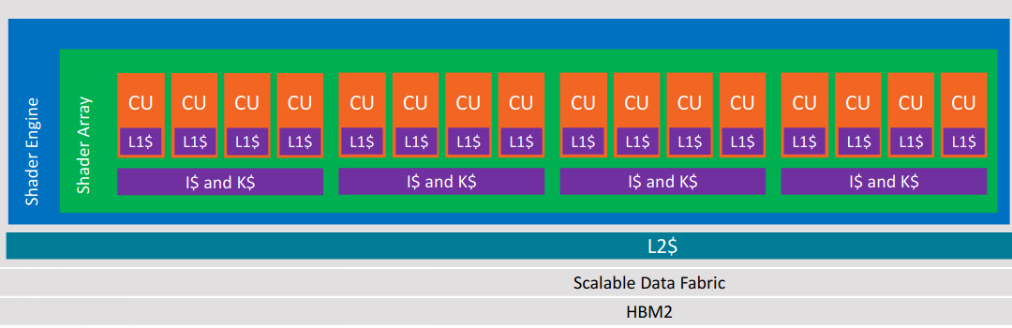
First Target: Vega-class GPU
Source: AMD
Added new HW support & configurations to model Vega GPUs
Extending to MI200/300
6
Notes:
Applying this methodology, we aimed to improve the accuracy of Vega 20 model. We added new hardware features and improved configurations to gem5 model. These changes can also be easily extended to the new MI200 and 300 GPUs.

Slide 7
Prior GAP Improvements
Overall, much better fidelity (from 37% to 6% geomean)!
But … main memory still has huge error (e.g., 88% for memory BW)
This Work: reduce main memory error (for GPUFS)
7
Notes:
After 4 iterative fixes, we drastically decreased error, from 37% to 6% geomean. However, if you look at individual metrics, memory system is still way off.
(Click)
The memory bandwidth has about 88% error.
(Click)
In this work, we are going to further close this memory bandwidth gap for Full system simulation.

Slide 8
Outline
Motivation
Design
Conclusion
8
Notes:
Here are the designs we introduced to improve it.

Slide 9
Issue #1: Insufficient HBM2 Support
Initial main memory BW error: 88% (gem5: 153 GB/s, real GPU: 1223 GB/s)
Observation #1: GPU model supported HBM(2), but not at high fidelity.
Solution #1:
  Modify GPU model to support a more accurate HBM2 controller [Akram, et al. gem5 Wkshp’22]
  Validation: achieve target bandwidth when directly connecting controllers to traffic generators
  New HBM model supports 1 TB/s like real GPUs!
Unfortunately, less effective sending traffic through the gem5 GPU to HBM2 model
9
Notes:
We have already known that the default GPU configuration uses a memory controller that doesn’t fully support HBM2
As previously reported by Akram et al., the old controller didn’t support correct timing parameters or pseudo-channel mode, which is critical feature for HBM2. Thanks to their work, we now have a much more accurate memory controller. We can just use this controller. To test it, we set up a standalone experiment using the new controller, where we instantiated memory with the same capacity as a real GPU, and then directly connected it to traffic generators. The results were promising, 1TB/s bandwidth achieved. The old controller couldn’t come close to this. So, we updated the GPU model, expecting big gains.

Slide 10
After HBM2 Support
Result #1: 153 GB/s → 166GB/s (86% error)
Something between CUs & memory controller must be the bottleneck
10
Notes:
But, after integrating the new controller into the GPU model, we only see slight improvement from the baseline 153GB/s to 166GB/s. Far from the real GPU.
Obviously, something else before the memory controller is causing the bottleneck. It is time to dig deeper into stats and traces to find out.

Slide 11
Issue #2: Larger Pages
Observation #2: ROCm 5 switched default to 2 MB GPU pages (from 4KB)
  Current gem5 GPU TLB model only fully supports 4 KB pages
  Consequence: many redundant translation requests when larger page used
Reality: Majority of GPU memory accesses are to 2 MB pages
  99.85% L3 GPU TLB misses were to 2 MB pages (511 redundant translations each)
  These redundant translations hurt memory system performance
Solution #2: add multi-page size support to gem5 GPU
  Larger page support reduces TLB misses
  Should also increase address translation performance
11
Notes:
One thing we discover from it is that the GPU frequently utilizes 2MB pages. This is because since ROCm5, the default GPU page size is 2MB. Unfortunately, the current GPU TLB model in gem5 doesn’t properly handle huge pages.
Why does it matter? Huge pages have many advantages, including more efficient address translation. Imagine scanning a continuous 2MB memory region. With 4k pages, you would go through more than 500 pages, potentially more than 500 TLB misses. But with 2M page, you would only have 1 or 2 pages, which is much fewer misses.
This was noticeable in our benchmark program, where over 99% of L3 TLB misses come from accesses to these 2M pages, not the standard 4K pages. The memory system performance was tanked by those redundant translations.
So, we need to add the multi-page size support to reduce TLB misses for better address translation performance

Slide 12
Issue #2: Larger Pages (Cont.)
Implementation:
  Coalescer does not know the request’s page size until request is returned
  Solution #2A: Coalescer buffers all req(s) potentially belonging to same larger page
    Trades off: increasing critical path if not a match vs. avoiding redundant requests
  Solution #2B: TLB properly maps the VA translation according to its page size
Both need upgrades
[Address translation queries] → TLB Coalescer → TLB → [next level]
GPU TLB Structure (per level)
12
Notes:
Before making any changes, lets first take a close look at the current GPU TLB model in gem5.
A level of GPU TLB has two major components, TLB coalescer and the TLB itself.
The TLB coalescer acts like request filter. In a given time window, it only lets one translation request per 4k page pass through to the TLB, while the other requests to the same page are buffered.
Once it receives the response from the TLB, the coalescer reuses the result to translate the buffered queries. It works, because you just need to know one translation per page. The Coalescer reduces redundant TLB lookups.
The TLB itself works much like a set-associative cache. It maps the virtual address to a TLB entry using the hard-coded 4k page size.
click
So, both Coalescer and TLB need large page support.
For the Coalescer, it doesn’t know the request's page size until it’s returned. We chose to make it speculatively buffer and stall all the requests potentially belongs to the same 2M page. If it turns out thats not a 2M page, the Coalescer re-coalesce the requests, falling back to 4k page size. This solution might increase the critical path if the speculation were wrong. But since there are a lot of 2M pages accesses, this drawback is minimal.
Finally, we make the TLB insert the translation according to the page size. At translation lookup, TLB searches for all possible page size.

Slide 13
After Multi-page Size Support
Result #2: 166GB/s → 302 GB/s (75% error)
Significant improvement, but something else still causing issues
13
Notes:
Did it work? Yes, it improves the bandwidth to 302GB/s. We can finally see some good improvements. but this is not enough.

Slide 14
Issue #3: Page Walk Overhead
Observation #3: Page walks expensive in multi-level page tables
  Each translation has multiple memory accesses
  Tuning page table latency helps, but does not resolve root problem
Solution #3: Add small page walk cache (PWC) to GPU page table walker
  PWC caches frequently accessed intermediate nodes in multi-level page table
  Reduces number of main memory accesses for each L3 GPU TLB miss
  Experimentally tuned size of PWC – 64-entries enough
14
Notes:
With our improved TLB model, TLB misses are still inevitable and costly. Every last-level TLB miss triggers a page walk, requiring multiple memory requests to traverse the page directory. It get worse if there is a data cache miss and requests go to the actual memory. We can tune this page walk latency, but it still relies on the memory system.
Our solution is page walk cache or PWC, which stores frequently accessed page directory entries. So, on TLB misses, there will be fewer memory requests. We tried several sizes. Small size, such as 64 entry is already enough to boost the memory bandwidth.
Eviction/invalidate?

Slide 15
After PWC
Result #3: 302 GB/s → 341 GB/s (72% error)
There is one more adjustment we can do to Network
15
Notes:
This further increases it to 341 GB/s. There is one more adjustment we can do to the network.

Slide 16
After Network Adjustments
Result #4: 341 GB/s → 583 GB/s (52% error)
Iteratively getting closer to target!
16
Notes:
The adjustments make the network to resemble the real GPU, which brings the memory bandwidth to 583 GB/s
As you can see, each improvement we added is making the memory bandwidth in gem5 GPU model one step closer to the real GPU.

Slide 17
Outline
Motivation
Design
Conclusion
17

Slide 18
Conclusion
Having validated “known good” gem5 models is important
  Existing GPU models do not always behave intuitively
  Point solutions insufficient
Solution: more automated framework (GAP)
  Prior GAP work: improve caches, specialized memories, FLOPs
But significant bottlenecks remain, especially for main memory → fixes:
  Higher fidelity main memory (HBM) model support
  Multi-size page support to reduce redundant, unnecessary translations
  Page walk cache to reduce overhead of page table walk
  Adjust network bandwidth to better reflect GPUFS system
Optimizations significantly improve gem5 GPU’s main memory BW
  Ongoing: identify further bottlenecks with main memory BW
  Ongoing: Continue to push support from this work → “known good” GPU models
18
Notes:
We have reiterated that it is important to have an accurate model. And we need a scalable method to validate those models. Thus, we created GAP framework. With it, we have made several improvements. However, main memory bandwidth is still inaccurate.
In this work, we have made additional improvements that noticeably increases the memory bandwidth.
However, the gap haven’t been completely closed. We are currently actively investigating other potential bottlenecks with the memory. Our group will keep working on validating GPU models for the community.
Thank you.

Slide 20
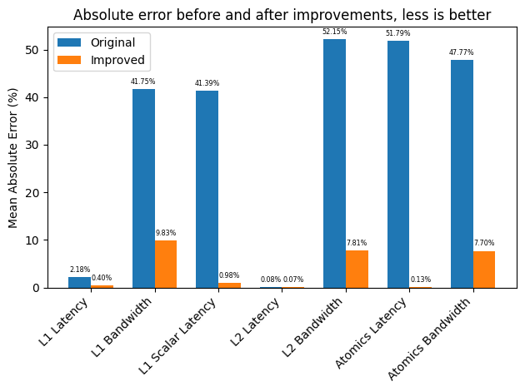
Baseline GPU Main Memory Status
Memory Bandwidth AMD Vega 20 —1223 GB/s
Memory Bandwidth in gem5 model —153 GB/s
87.49% error!
20
Notes:
All of these improvements have made the GPU model more accurate for caches and atomic operations. As you can see from the chart. Orange colored bars are the absolute errors after integrating our improvements. We can see drastically reduced errors.
But one challenge remains,,, that is the memory bandwidth, which hasn't been shown in the chart. We ran our benchmark on the actual Vega 20 GPU, and measured 1223 GB/s, which is very close to its rated 1TB/s bandwidth. However, in the gem5 model with similar configurations, it only has 153 GB/s, error of more than 87%. This gap is significant, and I will show how we improved it.

Slide 21
What Did We Fix Previously With GAP?
Introduced Dynamic Register Allocator for better parallelization
Introduced scoreboard for better tracking of register dependencies
Added support for Global-Level Coherence (GLC) and System-Level Coherence (SLC) operations
Tuned latency, sizes, and other parameters
21
Notes:
With the results of the microbenchmarks, we have already made several improvements, that aimed to enhance the simulation fidelity.
These include a dynamic register allocator and register dependency tracking scoreboard. They decrease the number of unnecessary stalls.
Next, we added loads and stores support for GLC and SLC (which are Global-Level and System-Level Coherence respectively).
Finally, after a great many of benchmark runs, we got a set of tuned parameters that reflects the real hardware.

Slide 22
What Did We Fix Previously With GAP? (Cont.)
Support for ROCm 4.0, 5.1 in SE mode; 6.2 in FS mode
Support for Carrizo-class dGPUs (gfx803)
Support for Vega-class dGPUs & APUs (gfx900, gfx902) and MI200/300 (gfx90a, gfx942) dGPUs
Validated, publicly available, tested benchmarks [Bruce, et al. ISPASS’21 Best Paper Nom.]
More realistic GPU register file model, improved concurrency via dynamic register allocation and VRF schemes
Improved concurrency via better dependency management
CU masking support to run kernels on a subset of GPU resources
Extend BLAS support to use kernels that run on real devices [Roarty, et al. gem5 Wkshp‘20]
Multi-chiplet support – more representative of future GPUs [Yogatama, et al. gem5 Wkshp‘20]
Properly report device properties for (ML) programs that dynamically select kernels
Study various cache replacement policies in GPUs [Jia & Sinclair gem5 Wkshp‘23]
…
Significant effort to model modern systems with high fidelity
22
Notes:
With the results of the microbenchmarks, we have already made several improvements, that aimed to enhance the simulation fidelity.
These include a dynamic register allocator and register dependency tracking scoreboard. They decrease the number of unnecessary stalls.
Next, we added loads and stores support for GLC and SLC (which are Global-Level and System-Level Coherence respectively).
Finally, after a great many of benchmark runs, we got a set of tuned parameters that reflects the real hardware.

Slide 23
import matplotlib.pyplot as plt
import numpy as np
x = np.array(["Base", "+HBMCtrl", "+TLB", "+PWC", "Target"])
y = np.array([153, 166, 302, 341, 1223])
plt.ylabel("Mem Bandwidth(GB/s)")
plt.bar(x,y)
plt.show()
23

Slide 24
gem5’s GPU Simulation Modes
AMD GPUs: ROCm stack to interface with CPU(s)
ROCm stack:
  Runtime layer – ROCr
  Thunk (user-space driver) – ROCt
  Kernel fusion driver (KFD) – ROCk (in Linux)
  MIOpen – Machine intelligence (MI/ML) library
  rocBLAS – BLAS (e.g., GEMMs) library
  HIP (LLVM backend, clang frontend)
Syscall emulation (SE) mode:
  Simulate all except ROCk, which gem5 emulates via docker
Full system (FS) model:
  Simulated disk image containing entire ROCm stack – great for deep co-design
24

Slide 25
gem5 CPU-GPU SE Mode: Modern App Support
System calls emulated through docker
(SE Mode)
APIs to HIP libraries
SE mode currently doesn’t support frameworks like PyTorch, TensorFlow
We added this support
[Alsop IISWC ‘19], [Roarty gem5 Workshop ‘21]
25

Slide 26
gem5 GPUFS Support
Introduced in gem5 v22.0
  Previously only supported SE mode with ROCm 4.0
  FS mode supports ROCm 4.2 & 6.4 without significant changes
  Can run many kernels of ML workloads like nanoGPT using PyTorch in gem5!
  This was not possible in any prior form of gem5
SE mode requires either specific host env containing ROCm stack or a Docker container that encapsulated this environment
  GPUFS removes all host requirements
Improves simulation speed by functionally simulating memory copies
Adds KVM CPU-GPU support
26

Slide 27
What is KVM CPU?
Kernel-based Virtual Machine (KVM)
  Open-source virtualization technology built into Linux
  Turns Linux into a hypervisor that allows host machine to run a VM
KVM CPU allows simulation to fast-forward by running the CPU instructions directly on the VM instead of on other gem5 CPU models
  Requires app binary to be compiled for the host machine architecture
CPU-GPU systems can use to fast forward through CPU code
27

Slide 28
gem5 GPUFS Mode Support: High-Level Frameworks
Disk image containing ubuntu-24.04 with ROCm 6.4, PyTorch, and other dependencies
App
PyTorch
gem5’s CPU model simulates the system calls
ML Frameworks make it easy to build large scale applications, but very slow to simulate completely
KVM x86 CPU
Can run MNIST, nanoGPT, etc. layers in public gem5!
28

Slide 29
About adjusted network bw
SimpleNetwork is unrealistic and inaccurate.
Bandwidth is scaled up to meet what a real GPU sees
We did this in SE mode to match the cache performance
Now do the same in FS mode.

Slide 30
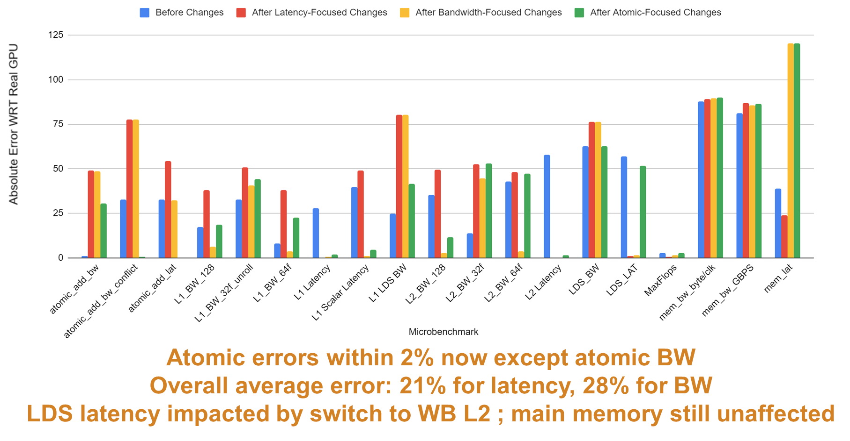
30

